Slide 1

Free Software
What | Why | How
Raghu
Free Software Movement Karnataka

Slide 2
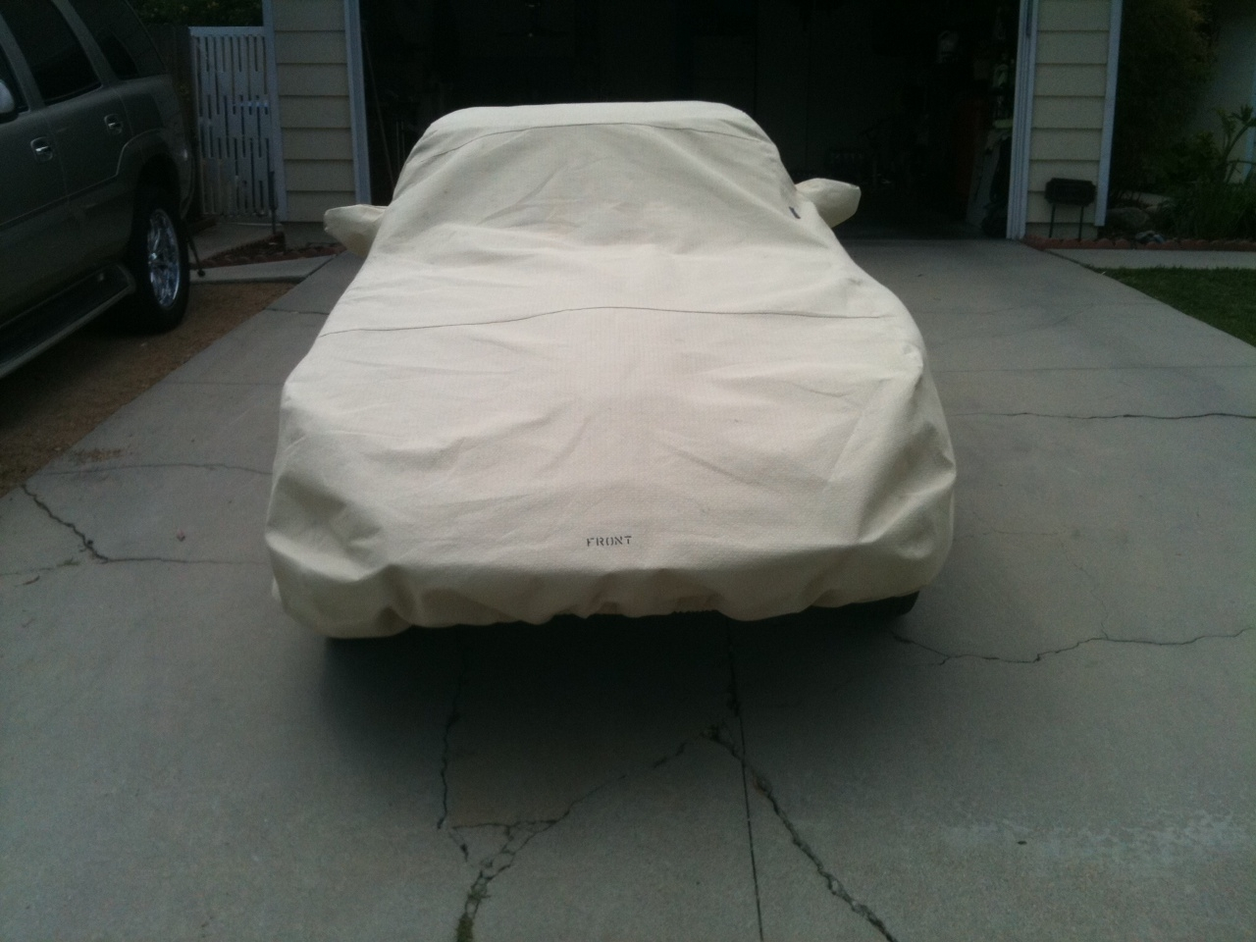
Wanna buy this?
Amazing Features*

Slide 3
* Terms and Conditions
The car comes in a 'hot pink' color. You shall not change the colour without permission.
You shall use the car only to drive to a mall and back. For other places, take permission.
You shall carry only one registered person in the car. For others, take permission.
You shall not lend the car to anyone (friends, family or colleagues), without permission.
The car's engine is sealed. You shall not open it. Permission won't be given at all.
[Please visit our world class service center, located on the beautiful Andaman islands]

Slide 4
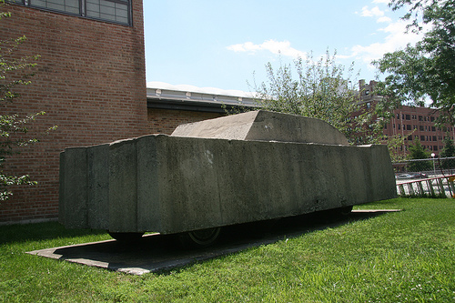
This is what you get!

Slide 5
What about Software?
Do you know that:
  You shouldn't install your software in someone else's system?
  You only get the permission to use the software for few allowed purposes? You CANNOT own the software?
  .... many more coming soon.
  Next time, try reading the END USER LICENSE AGREEMENT (EULA).

Slide 6


















How many do you recognize?

Slide 7
What is the solution?
Free Software

Slide 8
What is Software?

Slide 9
Understanding Free
The irony of the English language
  “Dude!! There's free dinner at the party tonight.”
  “Dude!! Where's my free speech?”

Slide 10
(Mis)Understanding Free
Free not as in
  Free Briyani
  Free Beer
  Free Antivirus with a Windows PC

Slide 11
Understanding Free Software
Free as in
  Freedom of speech
  Fight for Freedom
  Freedom Fighters
  Free from restrictions
Some people also call it Open Source.

Slide 12
What Freedoms?
std::freedoms Freedom[4];
Freedom[0] = to use for any purpose;
Freedom[1] = to study your software;
Freedom[2] = to redistribute your copy to anyone;
Freedom[3] = to modify/adapt your software;

Slide 13
Brief History
Free Software Foundation – Richard Stallman
GNU Project
GNU/Linux Operating System
The Linux kernel
The hacker culture
Free Software powers about 70% of the websites on the Internet.

Slide 14
How it works
Who makes them?

Slide 15
Benefits in General
Total Cost of Ownership
Support by the community (almost 24x7)
  e.g Word 95
Inculcates the value of sharing
Discourages the notion of 'sharing = stealing'

Slide 16
Benefits for Students
Let's recall something from an old famous story
An open environment to learn from experiences of others
Even the best of the best colleges/universities can't give you everything you need.
Your academic project can be the latest feature in the next version of VLC Media Player.
Your resume/CV could be just one page, still the best among thousands.

Slide 17
Advantages : Social
Bridging the digital divide
Software available in local languages
Our government data. Is it protected?
Solving local problems with global tools
FSMK's community centers

Slide 18
select * from student.doubts;

Slide 19
“You take the blue pill, you will wake up from your dream and remain where you are.
You take the red pill, I will take you through the rabbit hole and show you how deep it goes.”
Morpheus to Neo
The Matrix (1999)

Slide 20
What can you do?
Start your own community – GLUG
Gnu/Linux Users Group
  Knowledge sharing platform
Activities
  Technical Sessions
    Learn --> Share --> Contribute back to community
  Conduct Workshops
  Improve your labs
  Take up projects
  *** SECRET : most of the free software developers are students like you ***

Slide 21
How we will help
FSMK
  State level organization to support free software initiatives (part of FSMI network)
  Technology experts from IT industry
  Academic experts from various universities
  Guidance in taking up and executing Projects

Slide 22
Thank You!
fsmk-discuss@lists.fsmk.in

